Slide 1
Welcome to munch & crunch
Why we are here
To build relationships internally over data analytics
To learn and increase our firm wide capabilities
To explore opportunities to value add for clients
To keep abreast of technology development
July 23rd – Kick off
Today is about introductions and meeting new people
Understanding our individual skill sets
Identify opportunities for further learning
To help focus BDO Sydney’s data analytics offering

Slide 2
Insight driven organisations
How do we grow the data analytics service across BDO?
How do we understand ‘what clients need’? Not just what we sell.
Anyone engaging with clients can generate insights!
DA ‘voice of service line’ leaders – local leaders to discover insights
We capture insights using Teams and recording on our Planner board
We review, socialise the insights and act
Continue to engage with clients to discover insights beyond our core activities
Notes:
Some insights may not be client related. That’s ok, put on a separate list. We can review and determine action then.
We can also use analytics internally to drive better efficiency and client outcomes.

Slide 3
Does my business need analytics?
Make data driven predictions – No more guess work
How much should we charge for a particular item? (Price Optimization)
Where should we locate a new manufacturing plant? (Business Intelligence)
Who gets the latest catalogue or brochure? (Customer Intelligence)
What interest rate should each customer receive? (Risk)
Why are we losing customers in a particular region? (Customer Insight)
With the use of right data and appropriate analytical models, you will get answers to these questions and much more.
Top businesses are generally 6% more profitable than their peers when they rely on data-enabled decisions – MIT+ Wharton study

Slide 4
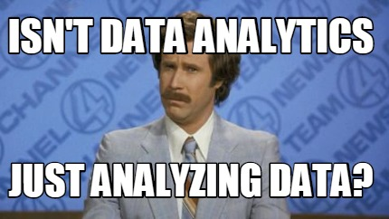
Data analytics is loosely used as a general term for any type of analysis done on data over time.
Stay classy.

Slide 5
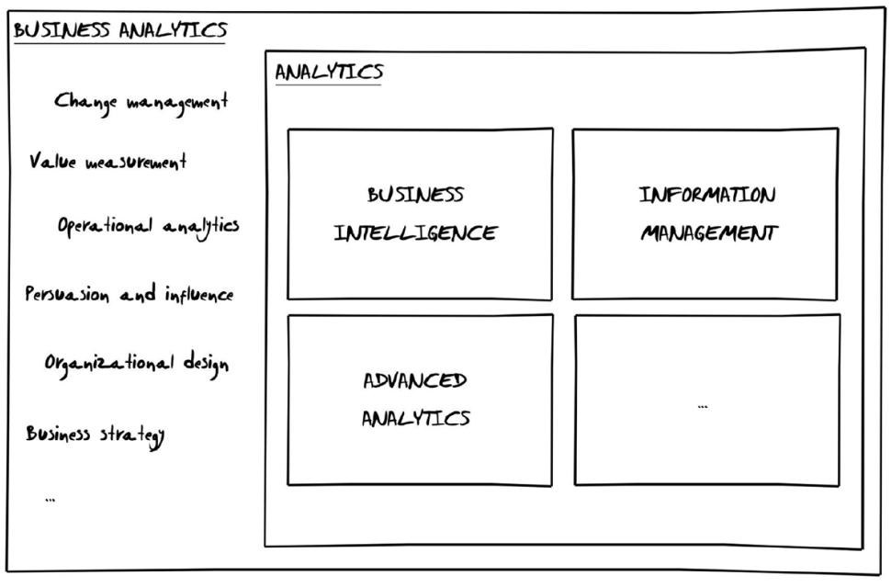
What is Business analytics?
It’s your Ability to Measure, Classify and Decide
Blend disparate data sources
Measure with precision
Classify with granularity
Apply to decisions
A More Formal Definition
Analytics is any data-driven process that provides insight.
Liebowitz, Jay. Business Analytics : an Introduction . Boca Raton, Florida: CRC Press, 2014. Print
Notes:
business analytics is about more than just analysis; while analytics and business analytics are sometimes used interchangeably, they have different foci. While essential, analytics is only a part of business analytics.
Analytics is any data-driven process that provides insight.
Common examples include:
Discovering which customers match certain characteristics through querying.
Summarizing organizational performance through reports.
Understanding sales performance through trending.
Grouping similar sets of customers together through segmentation.
Identifying what product a customer is most likely to be interested in through predictive modeling.

Slide 6
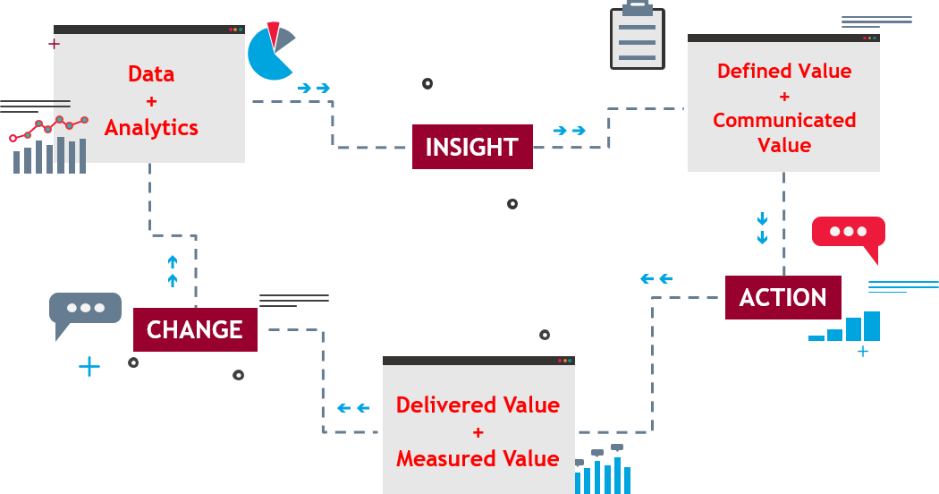
virtuous circle of business analytics
Strategic vision
Data when analysed, creates insight.
For insight to result in action, the value of the insight needs to be defined and communicated.
Trust is built through delivering and measuring the value that was promised leading to sustainable change.
Competitive advantage comes from creating and sustaining deep operational differences.
Notes:
To create a reason to act and support ongoing change, every business analytics initiative needs to:
Define the value, thereby building support and avoiding a lack of interest.
Communicate the value, thereby building understanding and avoiding confusion.
Deliver the value, thereby enabling tactical gains as well as long-term competitive differentiation.
Measure the value, thereby supporting ongoing transformation rather than one-off successes.
Data, when analyzed, creates insight. Insight alone rarely results in action. For insight to result in action, the value of the insight needs to be defined and communicated.

Slide 7
Flavours of Analytics
INCREASING COMPLEXITY
TRADITIONAL ANALYTICS
ADVANCED ANALYTICS
INCREASING VALUE
AUTONOMOUS
What should be done to handle changes?
Monitors, adapts and decides what should be done when an event occurs
PRESCRIPTIVE
What should be done?
Recommends optimal decisions that should be made based on trends
PREDICTIVE
What could happen?
Predicts possible outcomes based on past events
DIAGNOSTIC
Why it happened?
Identifies the root cause for the observed trends
DESCRIPTIVE
What happened?
Describes historical events as they happened
Notes:
The purpose of descriptive analytics is to reveal and summarize facts about what has happened in the past or, in the case of real-time analysis, what is happening in the present. This is done by examining and synthesizing data collected from a variety of sources. Raw data are captured and recorded in source systems, eventually to be cleaned, retrieved, and normalized such that entities and relationships can be meaningfully understood. The audience for descriptive analytics is broad, potentially reaching all functions and levels of an organization. Descriptive analytics are at the heart of most business intelligence (BI) systems.

Slide 8



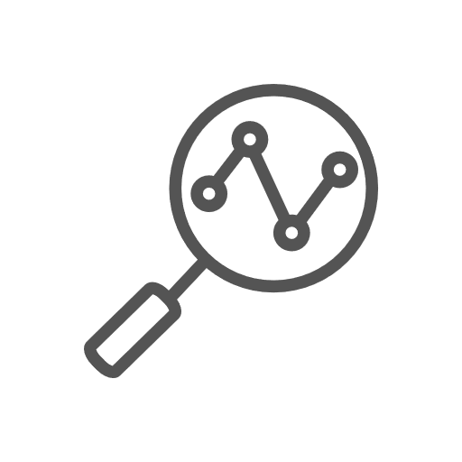

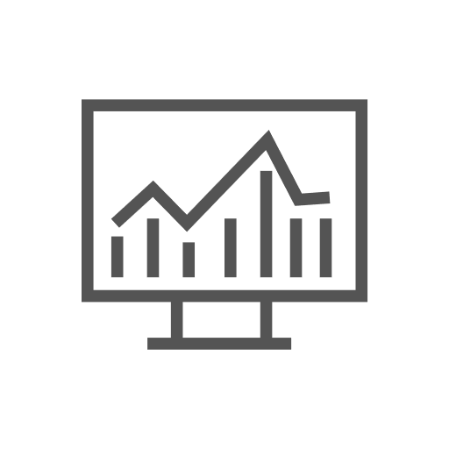
Our services
BDO provides a number of services to support your analytics journey.
Assess, prepare, plan and design
Develop, analyse, assure and secure
Maturity Assessments
Systems & Architecture
Analytics & Visualisations
Governance & Quality
Privacy & Security
Data Strategy
What is the analytics maturity of your firm? We help examine and assess the capture and use of data with your organisation. We offer recommendations on where to from there.
Data analytics is not just about technology. We help with the development of data strategies and roadmaps that are aligned to your business’ vision and objectives.
Multiple source systems, databases and cloud services, makes data management complex We review and provide advisory on optimising your information architecture to ensure it delivers a trusted system of record to all areas of your firm.
Data to be useful, needs to convey meaning. Reports and dashboards should deliver actionable intelligence to users across your firm. We help ensure you have the right data in the right hands.
We apply industry best practice frameworks to measure and improve your data quality.
Trust lost with users is not easily regained. Protect against your reputation and regulatory penalty. We provide security audits and privacy compliance checks.
Notes:
Capture data from across the business
Synthesise data and generate insights
Improve business outcomes

Slide 9

Data analytics in action
Who you are + service line
Your interest in data analytics
What you know – tools, languages, platforms
How you have helped clients in data analytics
Get our your phones and fill in the survey!

Slide 10
What’s next
Update your ADs and Partners in your service line
Join the Microsoft Teams (everyone will get an invite) - http://bit.ly/2XM71uW
Share articles, news, datasets, tools
Post questions on data analytics, help you need
Share client opportunities – Ryan & Anuj will come meet clients
Update the skills matrix
Update your records for your CDP
Come along to Munch and Crunch #2
Notes:
https://teams.microsoft.com/l/channel/19%3aa1628c77a89240a2807d019c9a6282c0%40thread.skype/General?groupId=2f2d4e4f-8b62-438b-9aba-06339d5a375f&tenantId=726066cc-3601-45e6-8065-5f62e8b46a79

